Slide 1
Files Comparison Python Project
Rahul Choudhary (Intern GNDEC)

Slide 2
PROBLEM STATEMENT
Aim to develop an automated system to match files received via SFTP (Secure File Transfer Protocol) to corresponding client information stored in an Excel file. The goal is to efficiently identify which client a particular file belongs to based on its name and path.

Slide 3
Conditions : 1. If File name in Email and Excel Matched return the Client Name 2. If File name does not match the with the File name in Excel look for File Path in Excel File Path if Matched Return the Client Name

Slide 4
Challenges
1. How to connect Python Script with Email 2. How to Read the content of Email using python Script
3. How to read the data from excel file and how to lookup for the File name 4. After File name how to lookup for File path

Slide 5
Approach :
1. Connect to the Gmail API using OAuth 2.0 authentication to read the latest email 2. script uses the google-auth library to handle OAuth 2.0 authentication. 3. necessary libraries installed (google-auth, google-auth-oauthlib, google-auth-httplib2, google-api-python-client, and pandas). 4.To define the scope using https://www.googleapis.com/auth/gmail.readonly 5. Read latest mails using read_latest_mail function 6. Using pandas

Slide 6
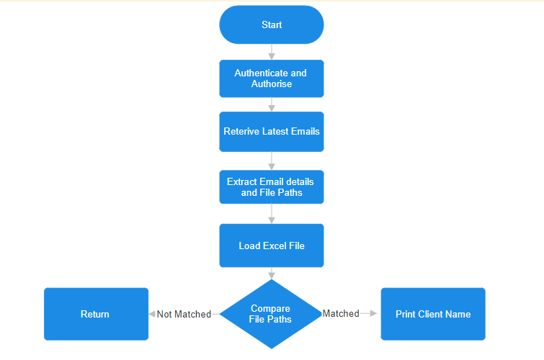
Work Flow

Slide 7
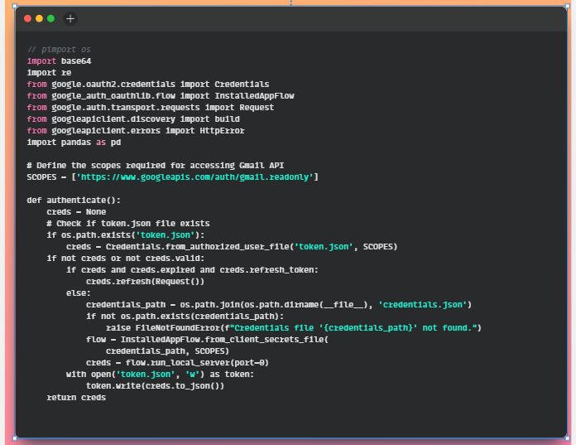
Connecting Email with python Script Code

Slide 8
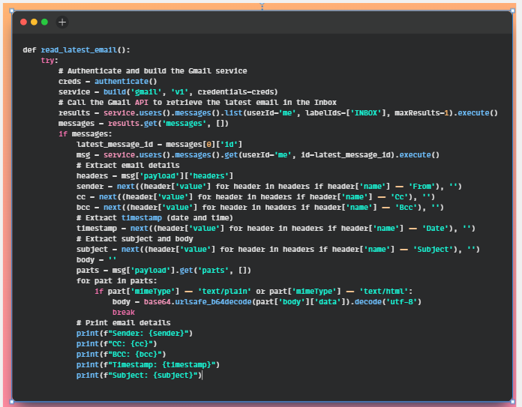
Reading Email using Python

Slide 9
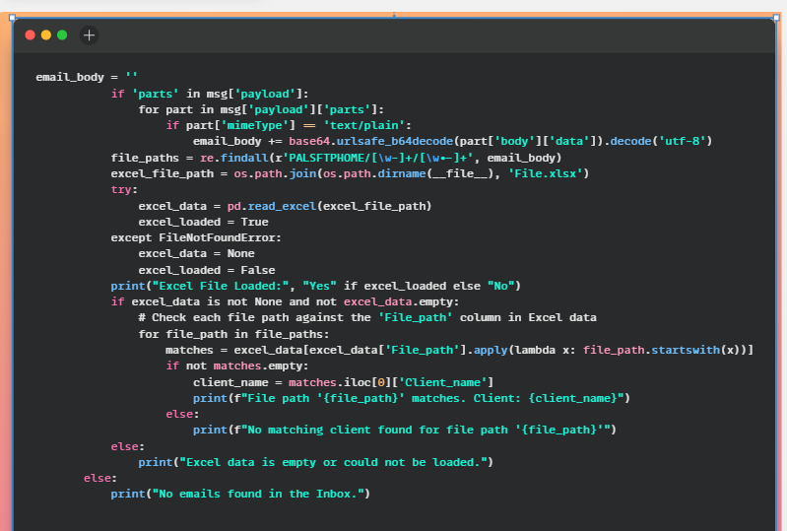
Loading Excel Data and Comparisons

Slide 10
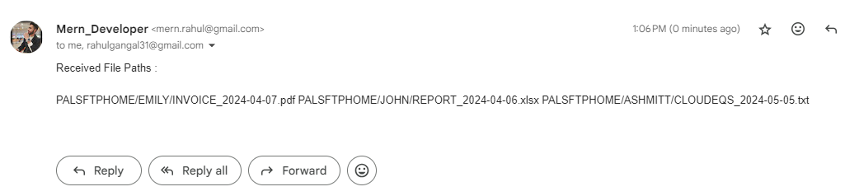
Testing :
Received Email :

Slide 11
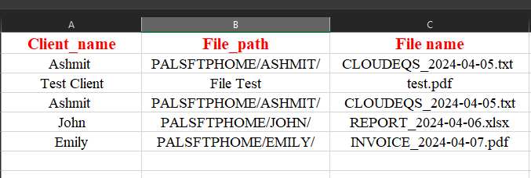
Sample Excel File :

Slide 12
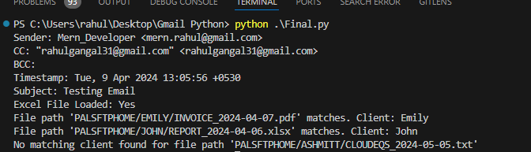
Output :

